Slide 1
Introduction to Operation Management
Outdoor Assignment (08/09/2024)
Submitted By 21JE0424 Jatin Pal

Slide 2
Choosing the best location for set up of a new facility:
“MoodLit Spaces”
Purpose and Vision: To create environment-themed reading lounges that offer books aligned with their surroundings—whether fitness, mindfulness, entertainment, or personal growth—enhancing relaxation and reflection for students and staff.
Location and Audience: Located near key areas like the SAC, garden, and high-traffic zones. These lounges attract students, faculty, and staff looking for a relevant and relaxing reading experience based on their environment.
Product Offerings and Operations: Each location offers curated books that match the setting—fitness near SAC, calming books by the garden, entertainment in busy areas. Open daily from 8 AM to 10 PM with cozy seating and themed events.
Following are the potential locations I have chosen:

Slide 3
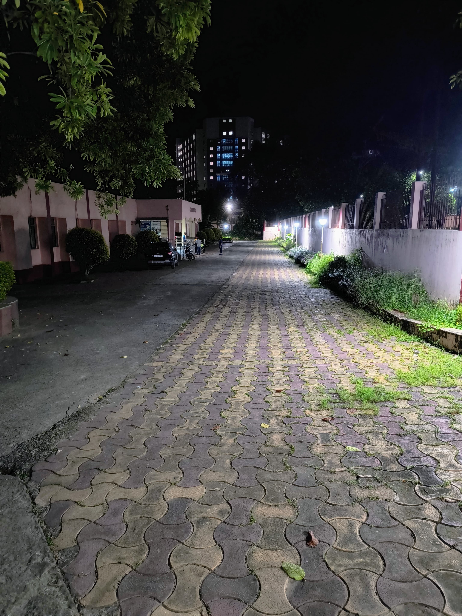
Location 1
The location is near the Student Activity Centre, a high-traffic area frequented by students, faculty, and staffs.

Slide 4
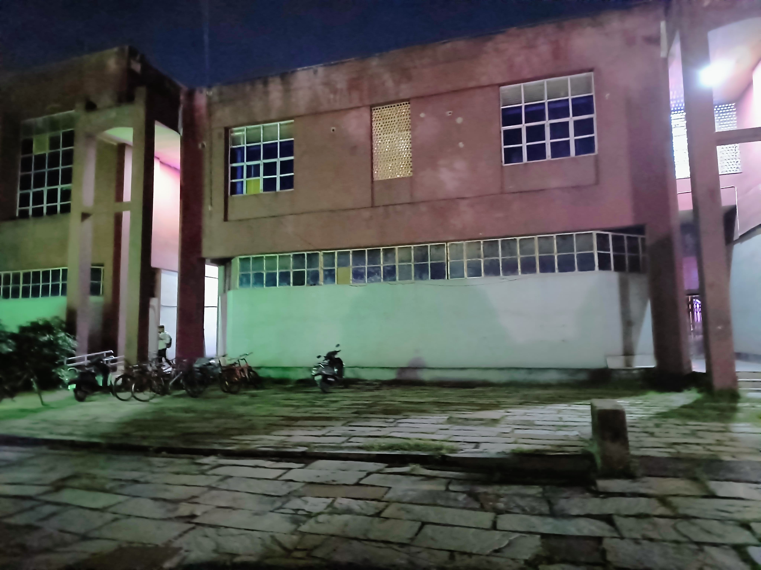
Location 2
The location is near the back of the Open-Air Theatre (OAT), at the junction of three main paths, making it a busy and accessible spot.

Slide 5
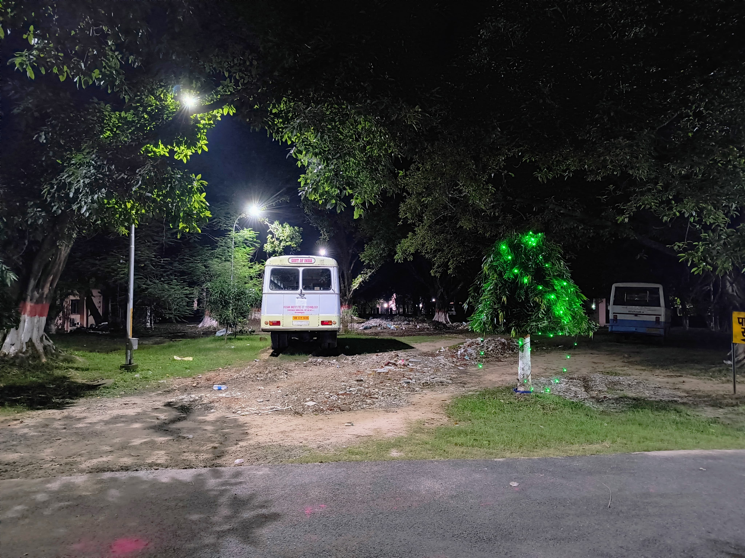
Location 3
The location is in front of the Diamond Hostel and the Heritage Building, making it an ideal and strategic spot for the shop.

Slide 6
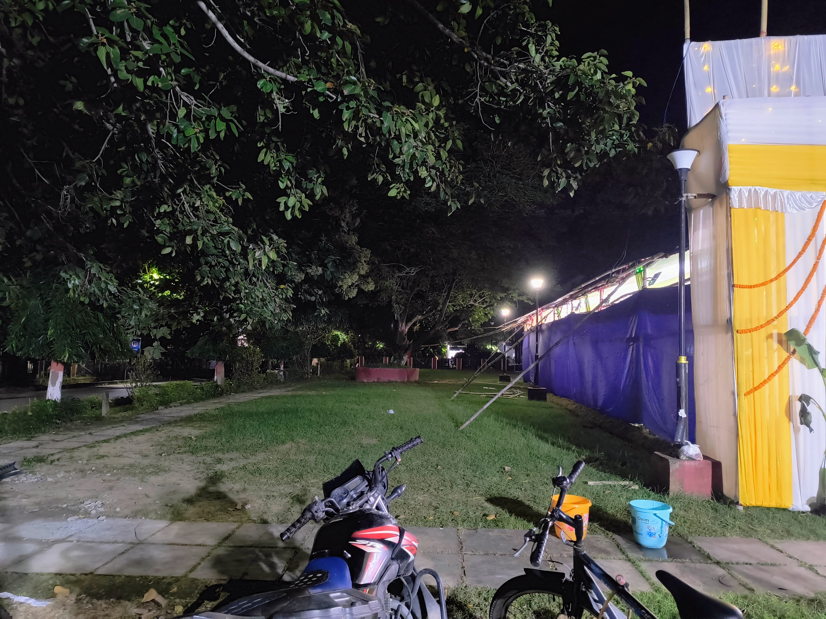
Location 4
The location is at the backside of the main canteen and near the Heritage Building, situated along the main path leading to the Heritage Building.

Slide 7
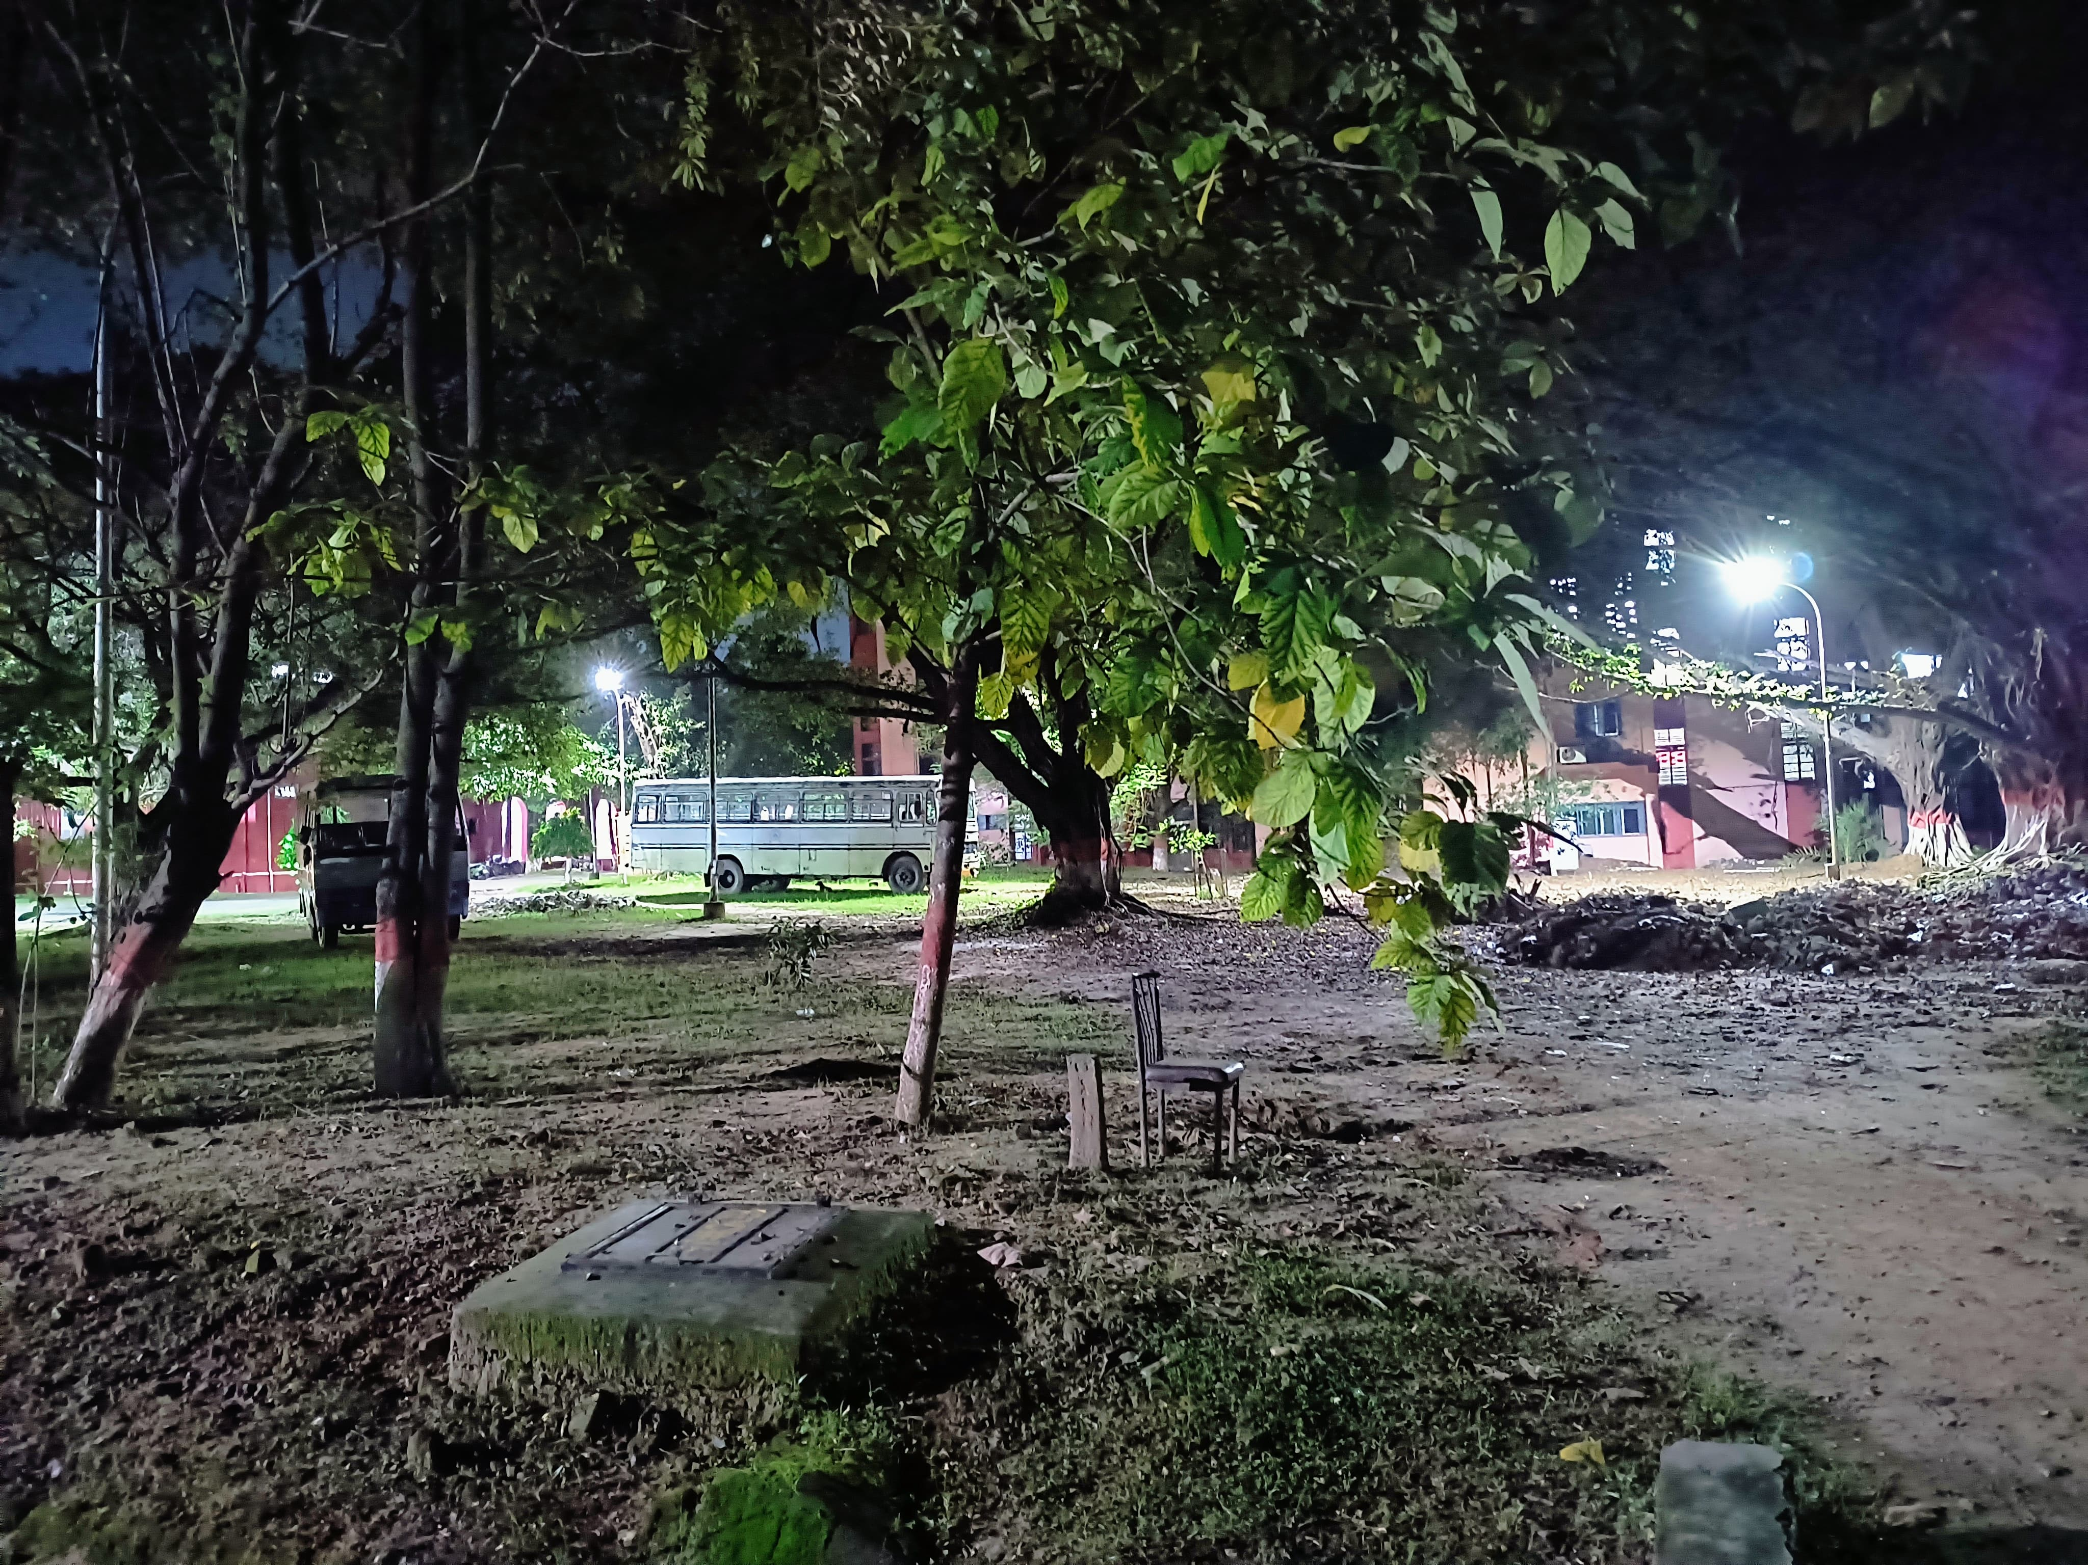
Location 5
The location is on the main road to Diamond Hostel, at the junction of three main roads, making it a prime spot for high visibility and traffic.

Slide 8
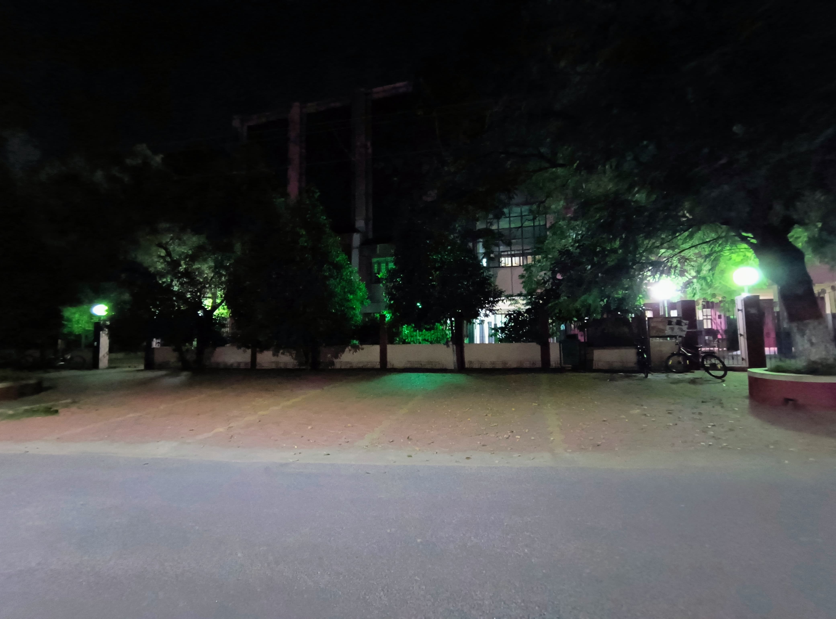
Location 6
The ideal location is in front of the New Lecture Hall Complex, one of the busiest and most trafficked areas on campus.

Slide 9
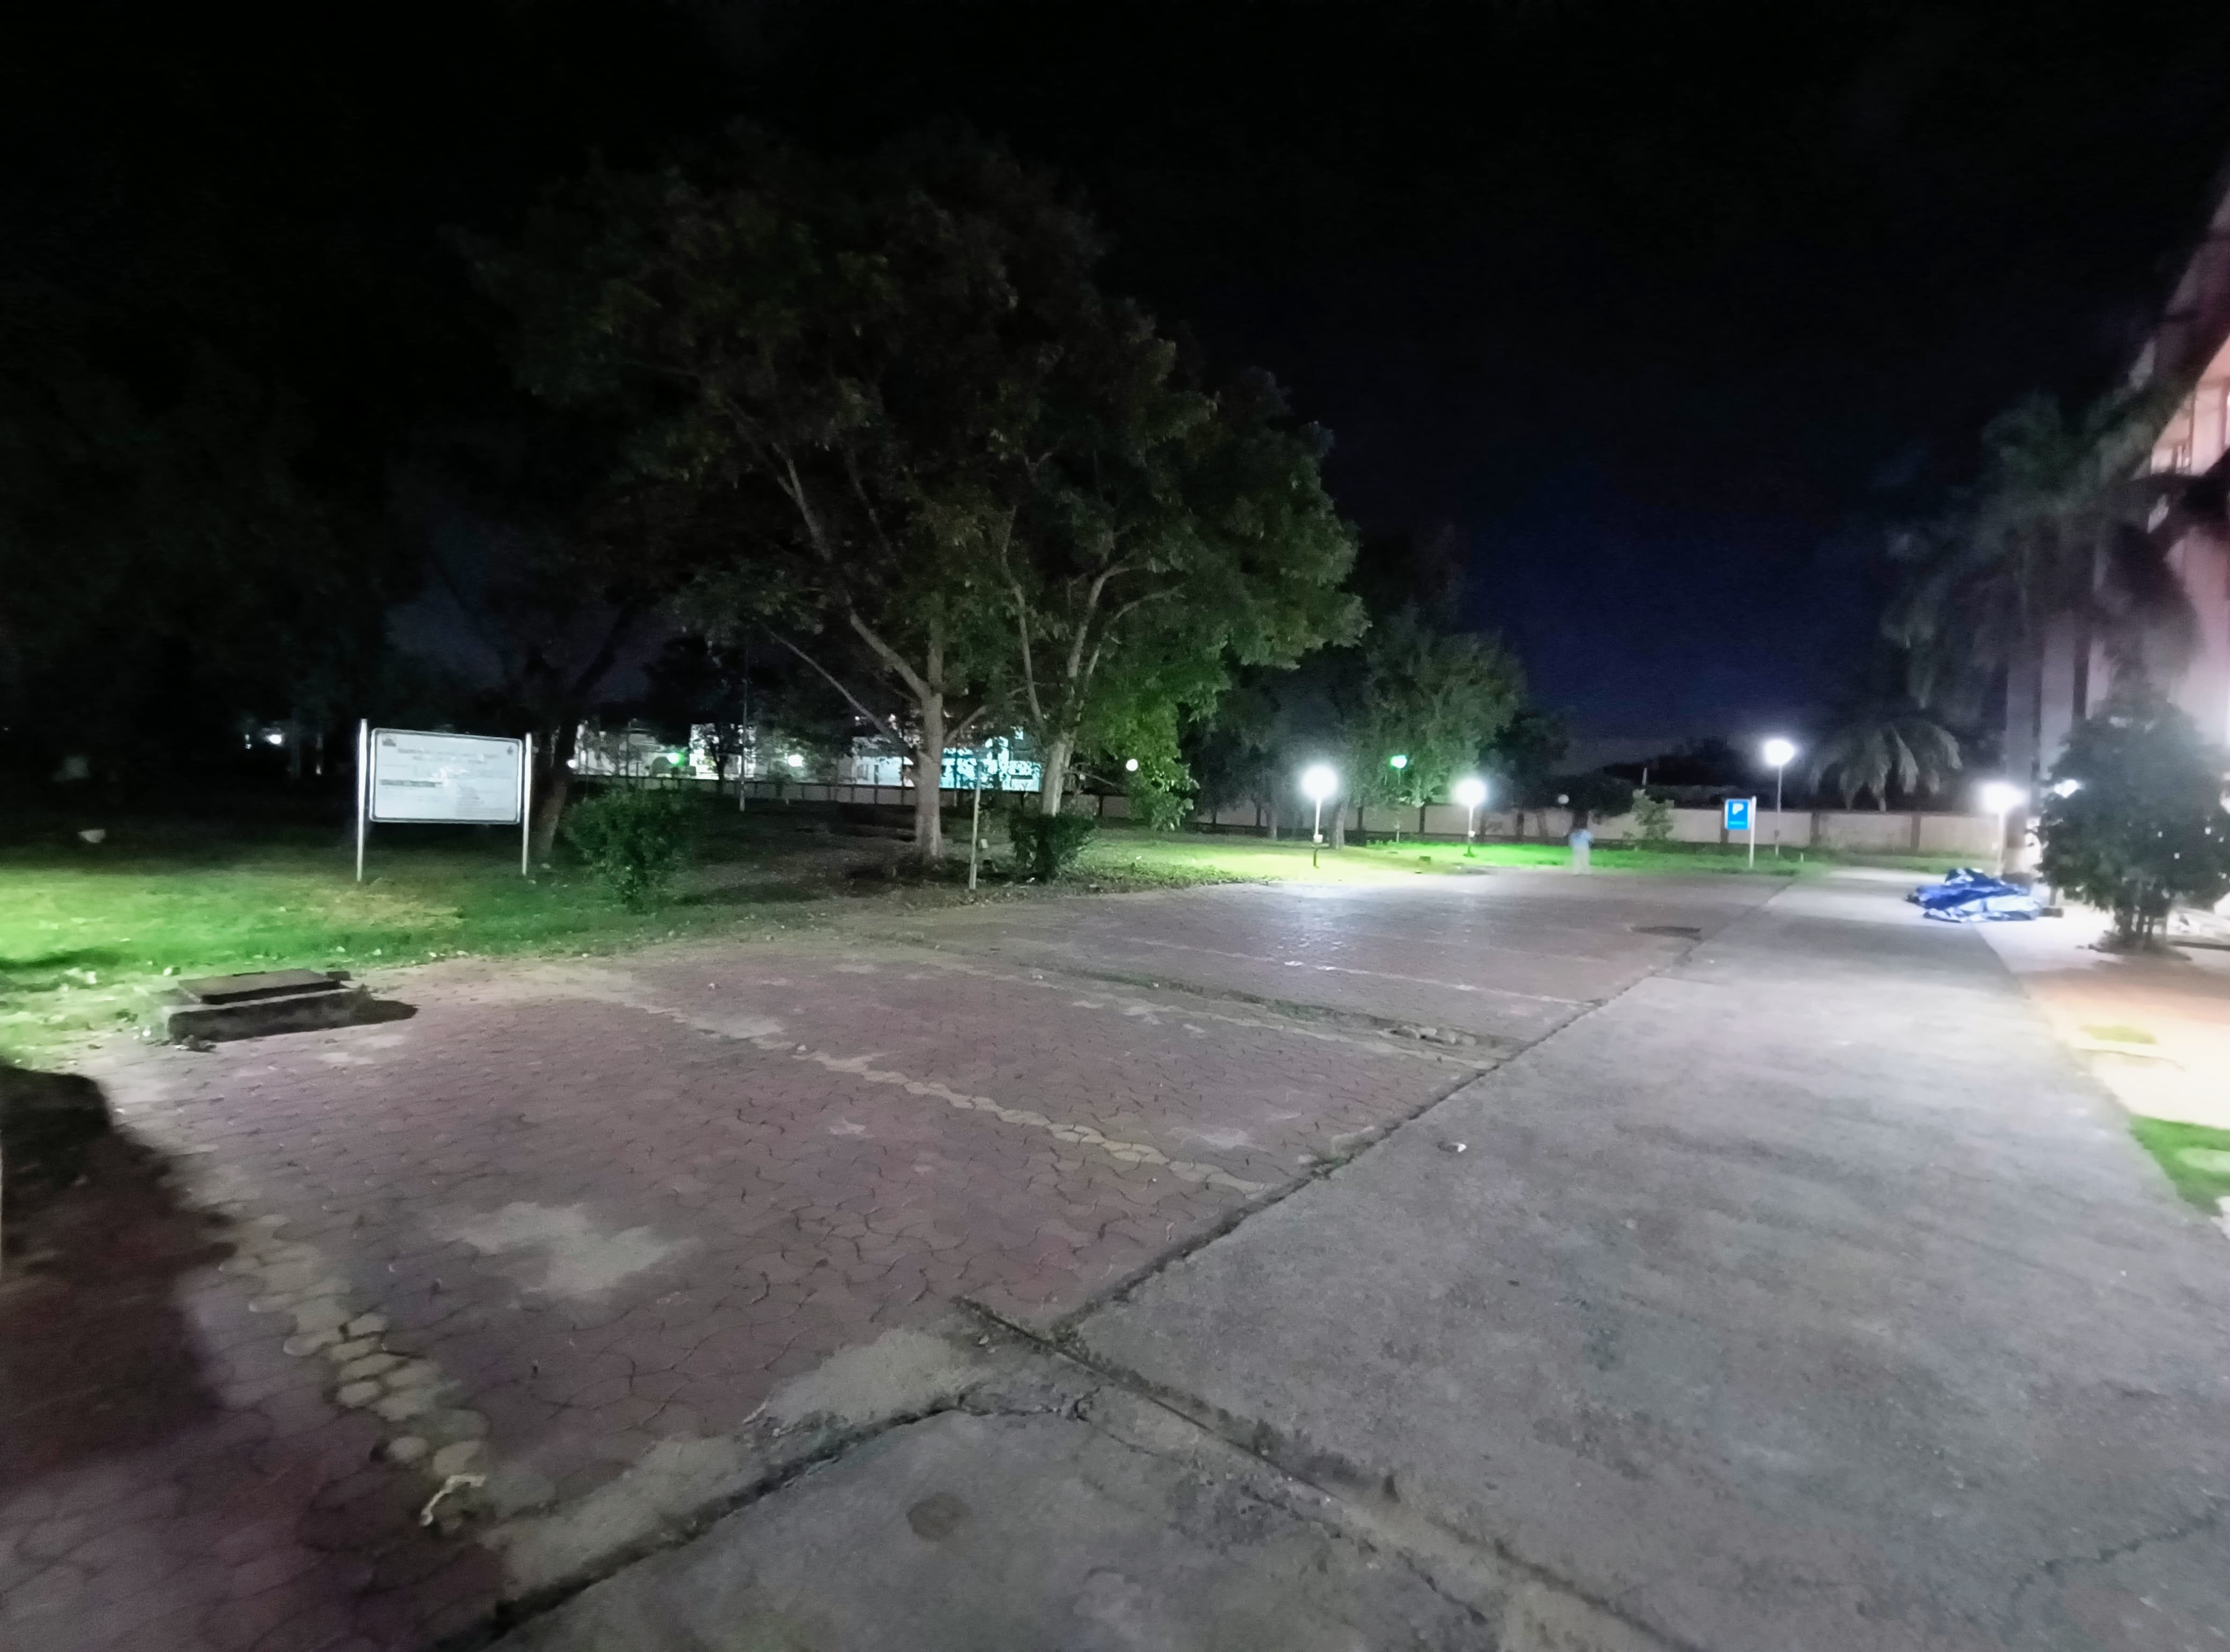
Location 7
The location is behind the Student Activity Centre (SAC) and at the back of the basketball court, offering a convenient spot for those frequenting these areas.

Slide 10
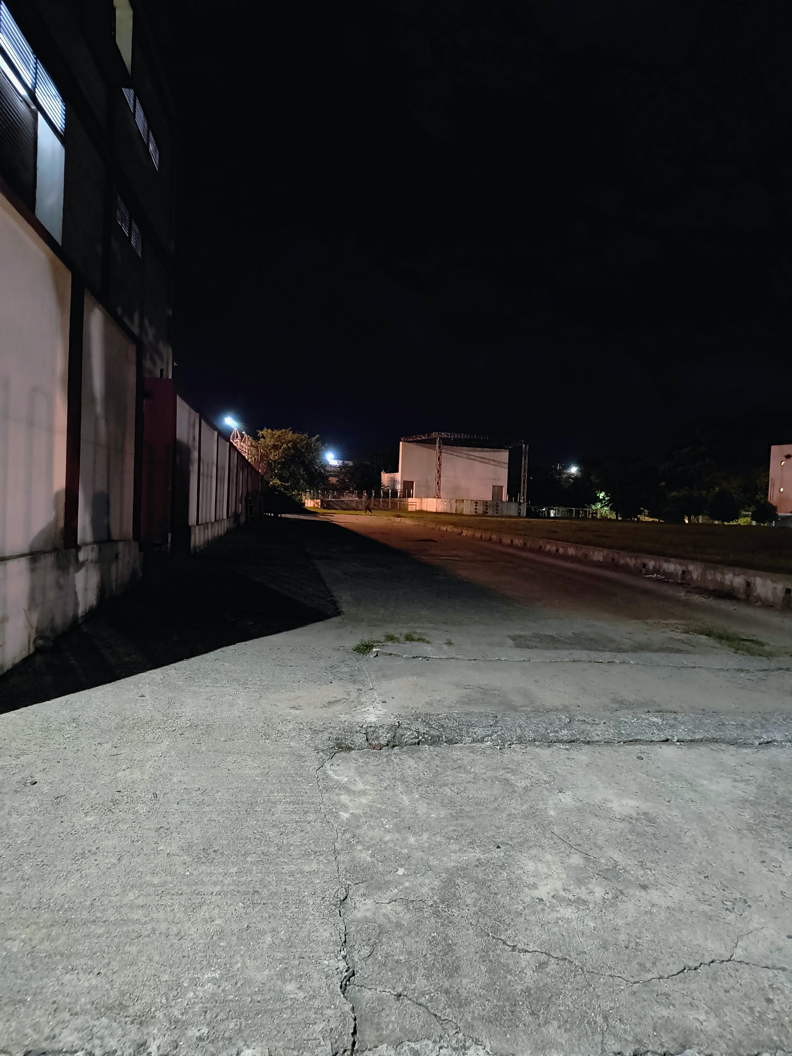
Location 8
This location is near the Gymkhana ground, along the path in front of the SAC and leading to the Aquamarine Hostel.

Slide 11
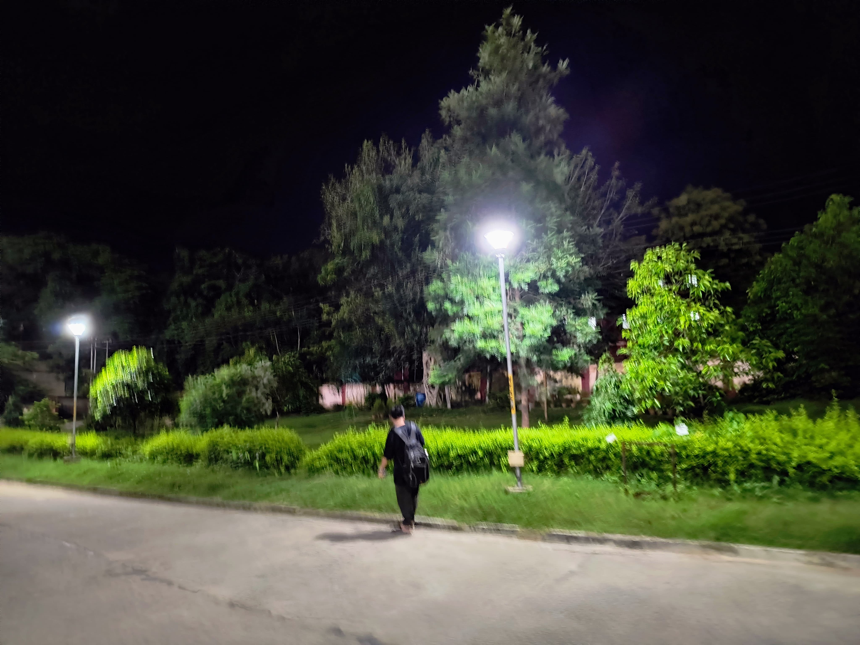
Location 9
This is in front of Jasper Hostel, along the path from NLHC to the library.

Slide 12
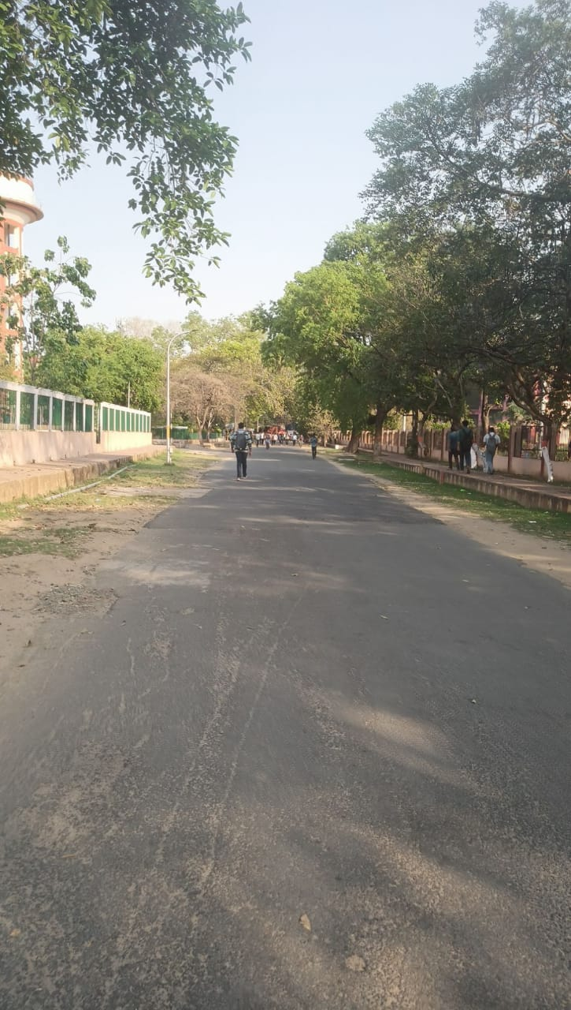
Location 10
This is the route from Aquamarine Hostel to NLHC, a busy road.

Slide 13
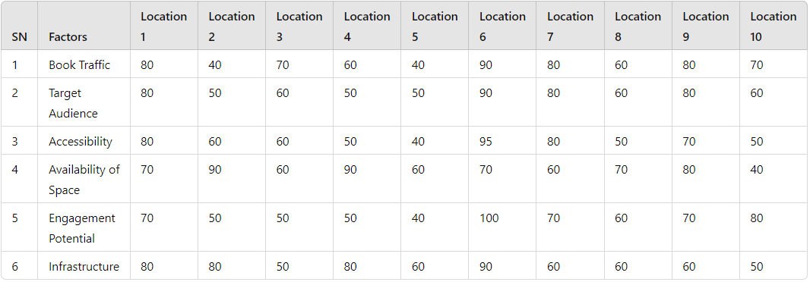
Rating of each location against each factor.
| Total | 460 | 370 | 300 | 380 | 290 | 535 | 420 | 360 | 440 | 350 |

Slide 14
Selection:
Location 6 scores the highest with 535 points, indicating it may be the most favorable option based on factors like traffic, audience, accessibility, and infrastructure.
Locations 1, 5, and 9 are also strong contenders, but Location 6 stands out due to its higher potential for engagement and accessibility.

